Slide 1
Natural language processing as a tool for workflow automation and social inclusion
-Shreejit Nair ___ -Sowmya Jandhyala

Slide 2
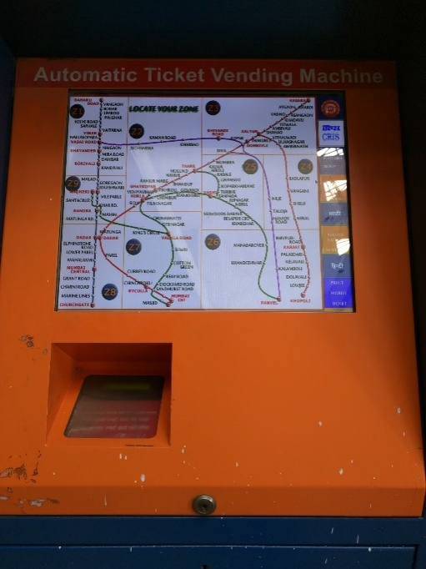
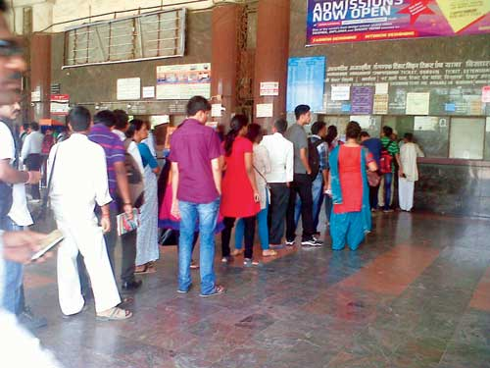

Motivation
Long queues for tickets (After)
Long queues for tickets (Before)
Kiosk for tickets
!!!PROBLEMS!!!
Our motivation is to solve this in a simplistic technique to extend such features to include apps in the real world.
For prototyping and demonstration, the domain we are using a flight reservation system in our project.
The simplest technique is to identify services provided by the device and simulate calls by passing data to such services.
Challenges – Resolving ambiguity in natural language text and machine translation allowing people from various backgrounds to interact seamlessly with the app.

Slide 3
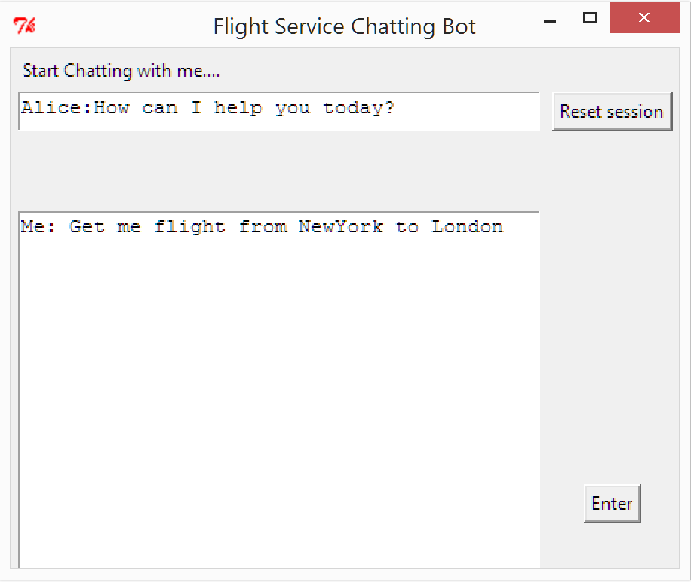
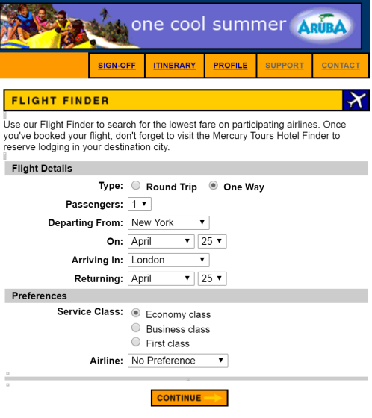
Technical approach
Search Flight
NER algorithm
Service call + Data
Register user
Convert input into custom named entities to identify service and pass data to the API
Natural language interface to ask for a service
Evaluation engine
Take input from the user
Convert into a NER problem with custom annotation (Get flight\service to London\destination)
Call the registered service passing the data and drive underlying website with this information
Conversation context is stored in a sqlite database

Slide 4
Experiments and Results
Sample .tok file representation:
Get | O
flight | SERVICE
from | O
New York | SOURCE
to | O
Chicago | DESTINATION
Classes : SERVICE, SOURCE, DESTINATION, LAST NAME, FIRST NAME, PHONE, EMAIL ADDRESS
Issues: Multi clause sentences becomes difficult
Issues in date representation: two days from now(relative and not absolute)
RESULTS
Service/Action | Training Set | Test Set | Accuracy
Search Flight | 25 | 25 | 64%
Register User | 24 | 32 | 52%

Slide 5
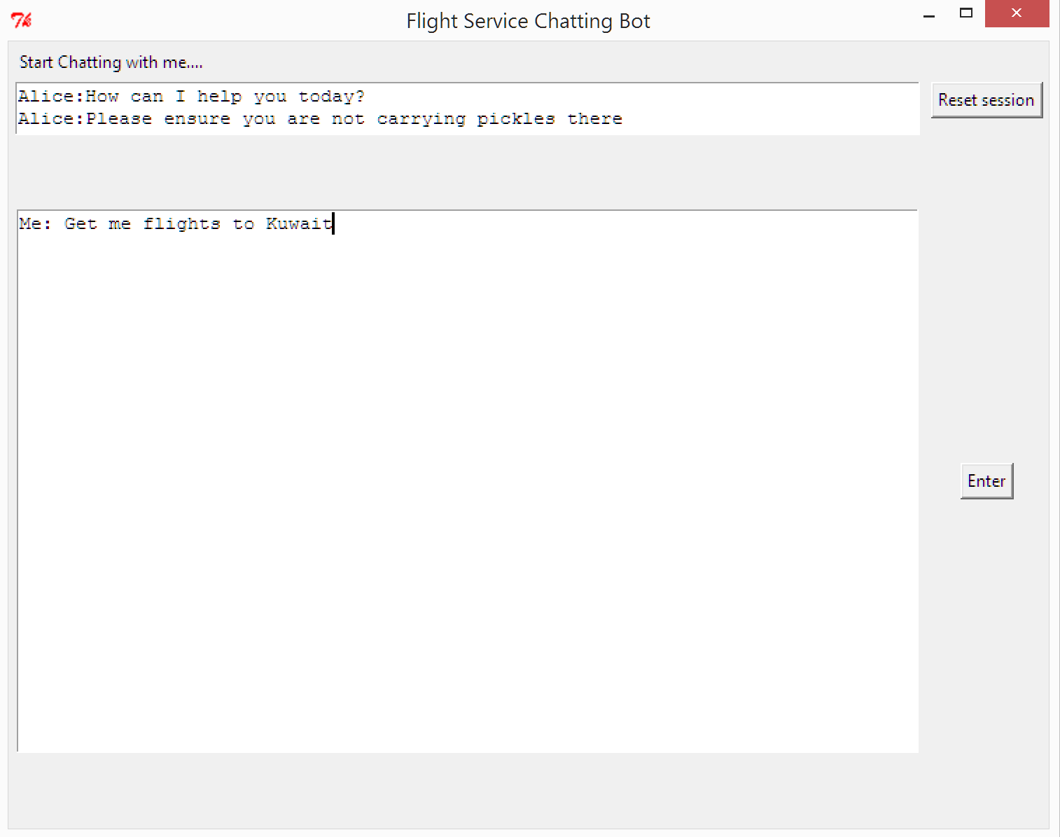
Summary
A lot of possibilities and scope to extend functionality across to various apps, kiosks and IOT driven devices. We believe the future will be all about interacting with applications in a more natural human-like way.
A combination of Machine translation + NLP + Information retrieval can provide for really interesting results.

